Slide 1

Example 1:
If you want to make an LED of blue color blink every 2 seconds while using an Arduino system frequency of 16 MHz using a timer to generate delay without any application of the built-in delay() function, select a suitable timer of the Arduino Uno for your application. Use a pre-scaler value of 256. Determine the necessary register set-up required for the program. A table of clock-select bits and register structures is given at the end of this question paper.
Answer:
Required delay = 2 s = 2000000 μs; Given system frequency = 16 MHz
So, clock period = 1/frequency = 1/16 MHz = 0.0625 μs
As such,
$$Timer count=\frac{Required delay}{prescalar (ps)×T}−1=\frac{\text{2000000}}{256×\text{0.0625}}−1=1,24,999$$

Slide 2
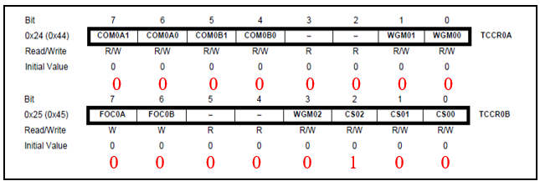
Example 1:
Timer 0 can count up to 255 and Timer 1 can count up to 65,535; so, neither Timer0 nor Timer1 of Arduino is suitable for this application, but with the use of a Timer Function Sub-Program that can generate 1 ms of delay upon each call of the function, any one timer may be used for 2 s time calculation. The timer will run in normal mode as such all values of the timer counter control registers (TCCRnx, here n = 0/1 and x = A/B) will be zero except for the clock select bits (CSn2:0) of the pre-scaler value of 256 in the TCCR0B or TCCR1B will be 100. If we use Timer0 then the register setup will be as follows:

Slide 3
Example 2:
Determine the outputs of the program and correct the program if there are any errors. Assume that a green color LED is connected to pin 5 and the Arduino frequency is 16 MHz. Compute the number of counts required for a 3 ms delay in each cycle for the given delay. Compute the number of times the while_true loop will run to execute the delays of LED ON/OFF times. Use a pre-scaler value of 1024.
#define YELLOW_PIN 10
int blue_on = 5000; // delay is given in ms
int red_off = 4000; // delay is given in ms
int delay_timer (int milliseconds){
int count = 0;
while(1) {
if(TCNT1 >= _____) {
TCNT1=0;
count++;
if (count == milliseconds) {
count=0;
break; }
}
}
return 0;
}
void loop() {
pinMode(GREEN_PIN, INPUT);
TCCR0A = 0b00000000;
TCCR0B = 0b00000100;
TCNT1 = 0x0000;
}
void loop() {
digitalWrite(BLUE_PIN, HIGH);
delay(green_on);
digitalRead(GREEN_PIN, LOW);
delay_timer(blue_off);
void loop() {
pinMode(GREEN_PIN, INPUT);
TCCR0A = 0b00000000;
TCCR0B = 0b00000100;
TCNT1 = 0x0000;
}
void loop() {
digitalWrite(BLUE_PIN, HIGH);
delay(green_on);
digitalRead(GREEN_PIN, LOW);
delay_timer(blue_off);
Prescaler values and corresponding register contents.
CSx2 | CSx1 | CSx0 | Prescaler
0 | 0 | 1 | 1
0 | 1 | 0 | 8
0 | 1 | 1 | 64
1 | 0 | 0 | 256
1 | 0 | 1 | 1024

Slide 4
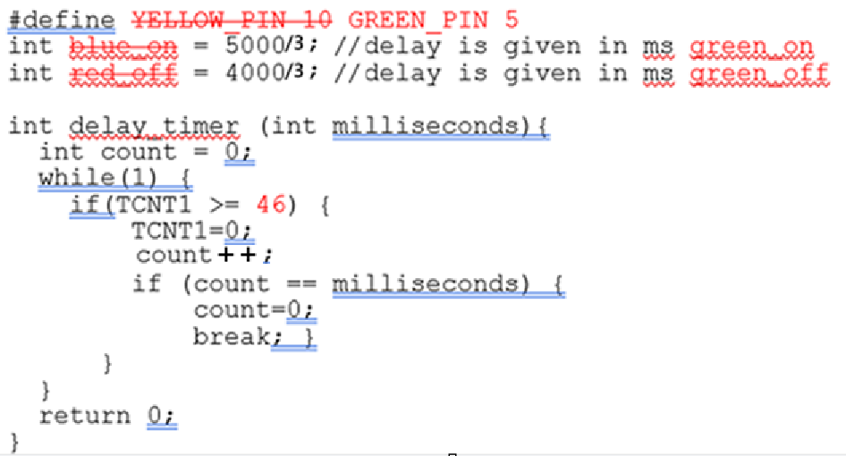
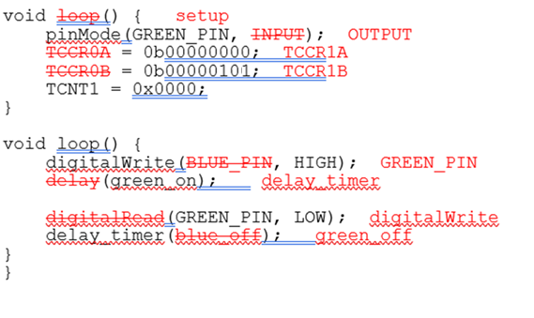
Example 2:
Answer:
Corrected Codes

Slide 5

Example 2:
The output of the program is: A green LED connected to pin 5 will be turned ON for 5 s and OFF for 4 s and this ON-OFF status will be repeated indefinitely after correcting the program (shown in the program above with the wrong parts stroked through in red color) until the microcontroller’s power is turned OFF.
Given system frequency = 16 MHz; So, clock period = 1/frequency = 1/16 MHz = 0.0625 μs
Required delay = 3 ms = 3000 μs
$$Timer count=\frac{Required delay}{prescalar (ps)×T}−1=\frac{\text{3}\text{000}}{1024×\text{0.0625}}−1=46$$
The number of counts required for a 5 s (5000 ms) delay in each cycle for the LED ON time = 5000 ms/3 ms = 1667. The number of counts required for a 4 s (4000 ms) delay in each cycle for the LED OFF time = 4000 ms/3 ms = 1334.
Timer0 can count up to 255 and Timer1 can count up to 65,535; Timer1/0 is appropriate for this application.

Slide 6

Example 3:
If you want to make an LED of red color blink every 4 seconds while using an Arduino system frequency of 16 MHz using a timer to generate the delay without any application of the delay() function, which timer of the Arduino Uno is suitable for your application? You may use a pre-scaler value of 256/1024. Write the necessary register set-up required for the program.
Given system frequency = 16 MHz; So, clock period = 1/frequency = 1/16 MHz = 0.0625 μs; Required delay = 4 s = 4000000 μs
$$Timer count=\frac{Required delay}{prescalar (ps)×T}−1=\frac{\text{4}\text{000}000}{1024×\text{0.0625}}−1=62499$$
But Timer 0 can count up to 255 and Timer 1 can count up to 65,535; so Timer1 is suitable for this application.

Slide 7
Example 3:
void setup() {
pinMode(REDLED_PIN, OUTPUT);
TCCR1A = 0x00; // Since Timer1 is used, so control registers of Timer1
TCCR1B = 0x05; // are used in this program instead of registers of Timer0.
TCNT1 = 0x0000;
}

Slide 8
Example 4:
A security company boasts of their tightknit security systems to its clients. Their systems run continuous security sweeps. The rate of their sweeps varies based on the client’s subscription model. The premium model offers a sweep every 15ms whereas the basic model runs the sweep every 40ms. Their system is based on Arduino Uno platform running at 16MHz.
a) Compute the necessary timer counts to achieve the required delay for the premium and the basic model.
b) If the system is using only a 16-bit timer and if the available prescalers are 8, 64, 256 and 1024, compute the maximum possible time to be counted for the premium and the basic model with the help of this 16-bit timer.
c) Prepare the necessary registers associated with the 16-bit timer to achieve the necessary time counts calculated in Q1. Consider the timer to be running at normal mode.
CS12 | CS11 | CS10 | Prescaler
0 | 1 | 0 | 8
0 | 1 | 1 | 64
1 | 0 | 0 | 256
1 | 1 | 1 | 1024

Slide 9
